Slide 1
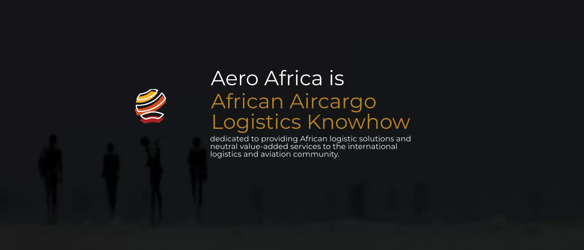

Slide 2
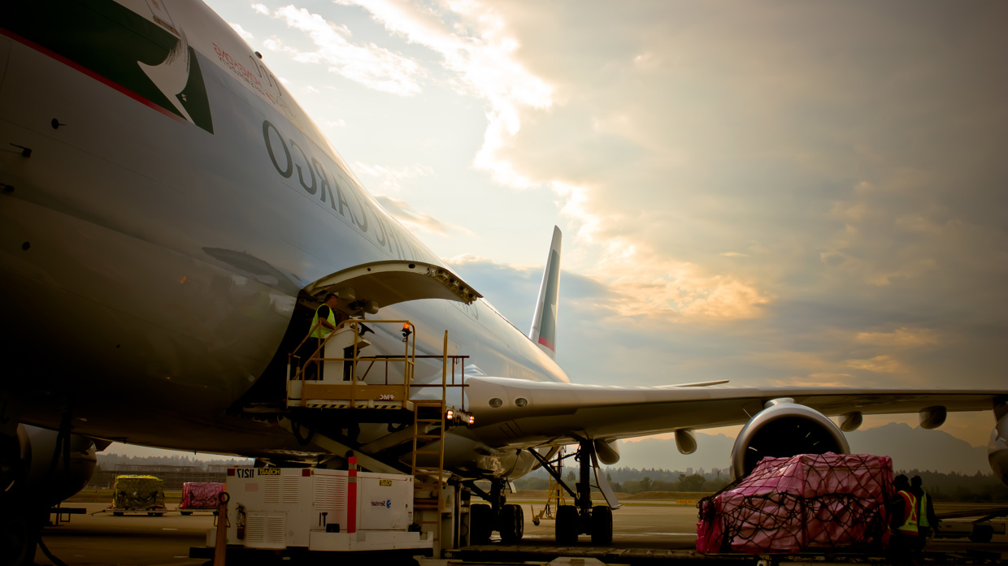


Who are we?
AERO AFRICA
is a leading air cargo management group dedicated to providing African logistic solutions and neutral value-added services to the international logistics and aviation community.
www.aero-africa.com
management@aero-africa.com

Slide 3

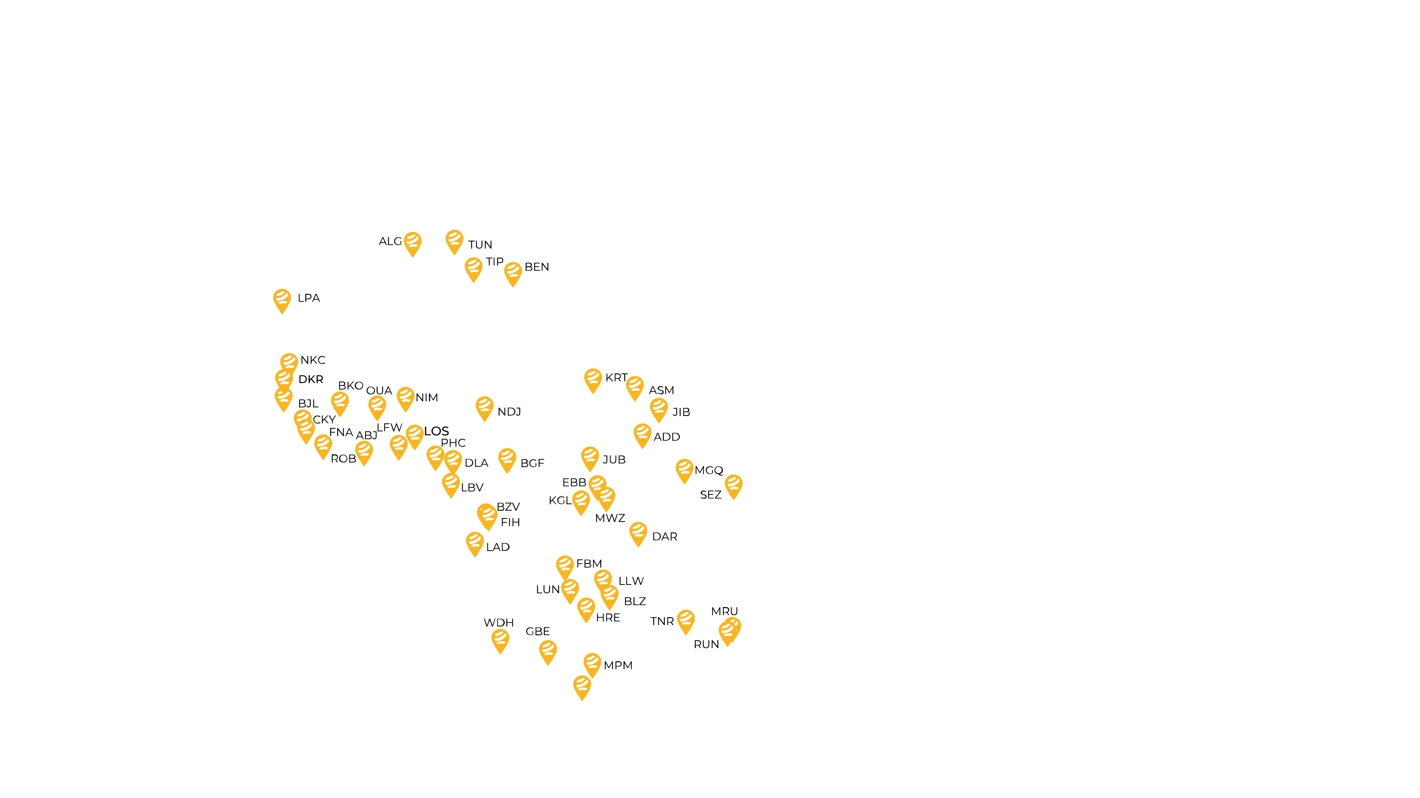
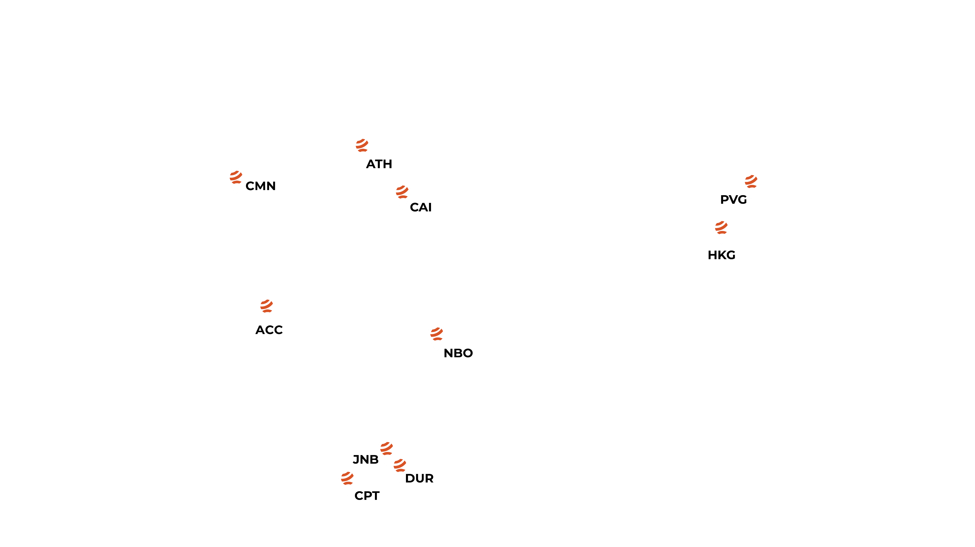



Aero Africa
NETWORK
84
airports
COVERING
54
countries

Slide 4


Advantages
Reach
Expertise
Efficiency
Reliability
African network in 84 airports with selected air cargo experts
Advanced air cargo logistics expertise and experience to navigate the African landscape
Avoid complexity and transact safely with a unified & centralized accounting centre
Hands-on approach with regional service centres to ensure reliable and seamless operations

Slide 5
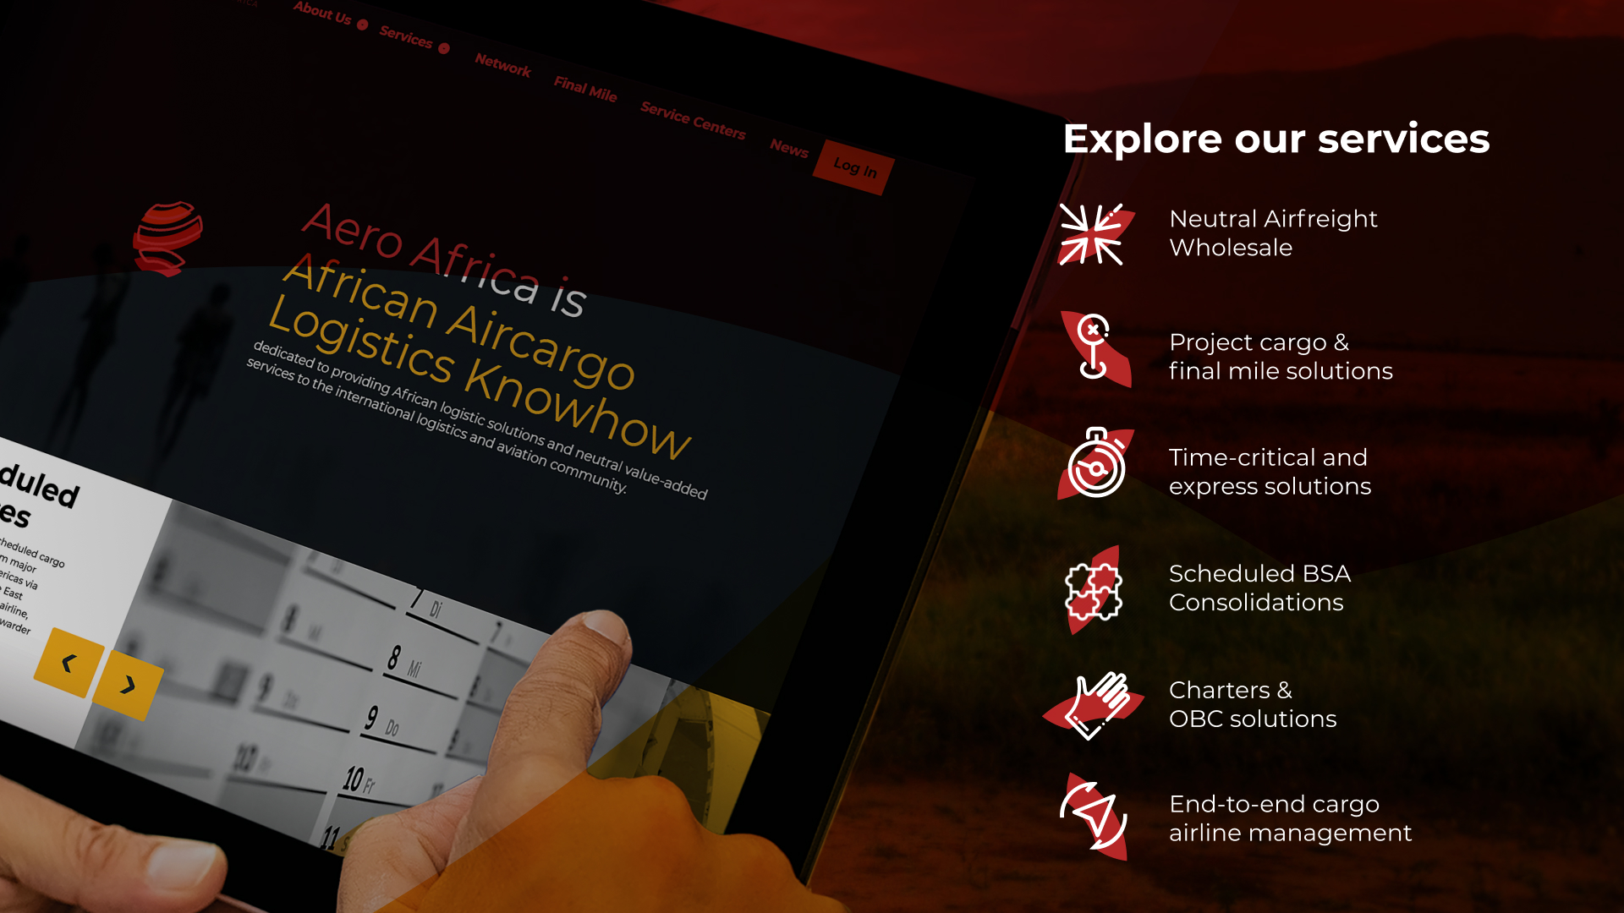
African Network Solutions
Charters & OBC
Airline Network Solutions & Total Cargo Management

Slide 6
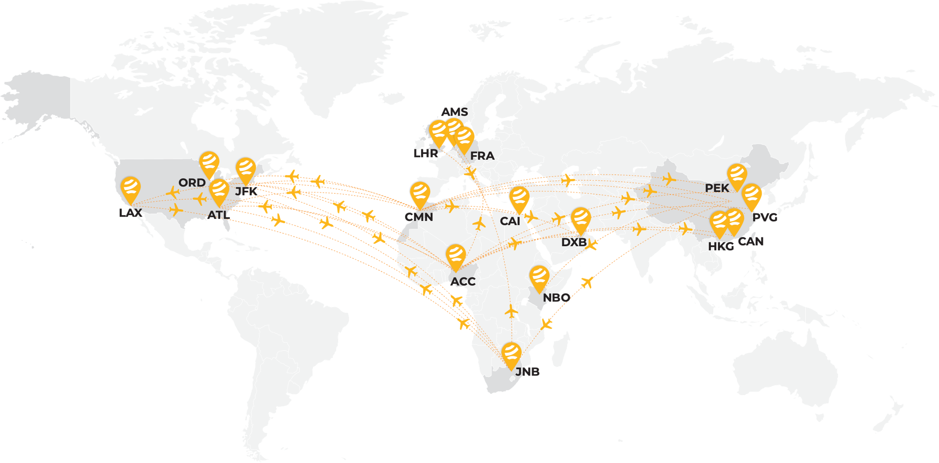
Aero Africa
NEUTRAL SCHEDULED
BSA CONSOLIDATIONS

Slide 7


Neutral Airfreight Imports
Global network of own offices and neutral partners
Weekly scheduled consolidations
Block space agreements with carriers
Direct & Back 2 Back services
Door 2 Airport
Neutral cargo handling
Airport cargo transfers & drop-offs
Third party documentation
Neutrality guaranteed
Special cargoes handling
Aero Africa is the leading global airfreight wholesaler and neutral BSA consolidator to Africa.
With a vast network, Aero Africa stands out as a reliable solution for your importing requirements. No matter where you need to ship from, our diverse range of products and solutions are tailored to suit your business. We handle all aspects of the procedure, ensuring a quick and efficient import service. From any origin, regardless of frequency or delivery timeline, we will deliver a seamless import experience.

Slide 8
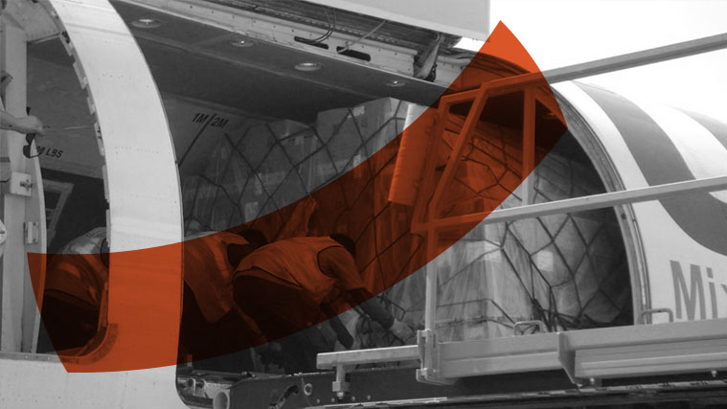
Neutral Airfreight Exports
Scheduled consolidations
Pre-booked capacity with airlines
Credit facilities with all carriers
Back 2 Back
Direct AWBs
Airport 2 Door
Freight collect
Neutral cargo handling
Airport cargo transfers & drop-offs
Third party documentation
Air export support services
Neutrality guaranteed
Special cargoes handling
In the fall of 2023, we launched our neutral airfreight export service in South Africa.
Due to our focus on delivering superior services and customer first approach, we quickly rose to the top 3 consolidators and top 10 cargo agents & in Africa in terms of volume.

Slide 9




Perishable Cargo Handling
Complete solutions for all perishable cargo
Part 108 and PPECB certified operations with
on-site inspection office
Expert ULD build-ups meeting airline-specific requirements
Competitive rates with global carriers
Temperature-controlled transportation
within OR Tambo vicinity
We specialize in preserving the quality and value of your temperature-sensitive shipments throughout their journey.
Our dedicated 500sqm facility at OR Tambo International Airport combined with our team of specialized experts will ensure that your perishable cargo arrives in optimal conditions

Slide 10



Slide 11
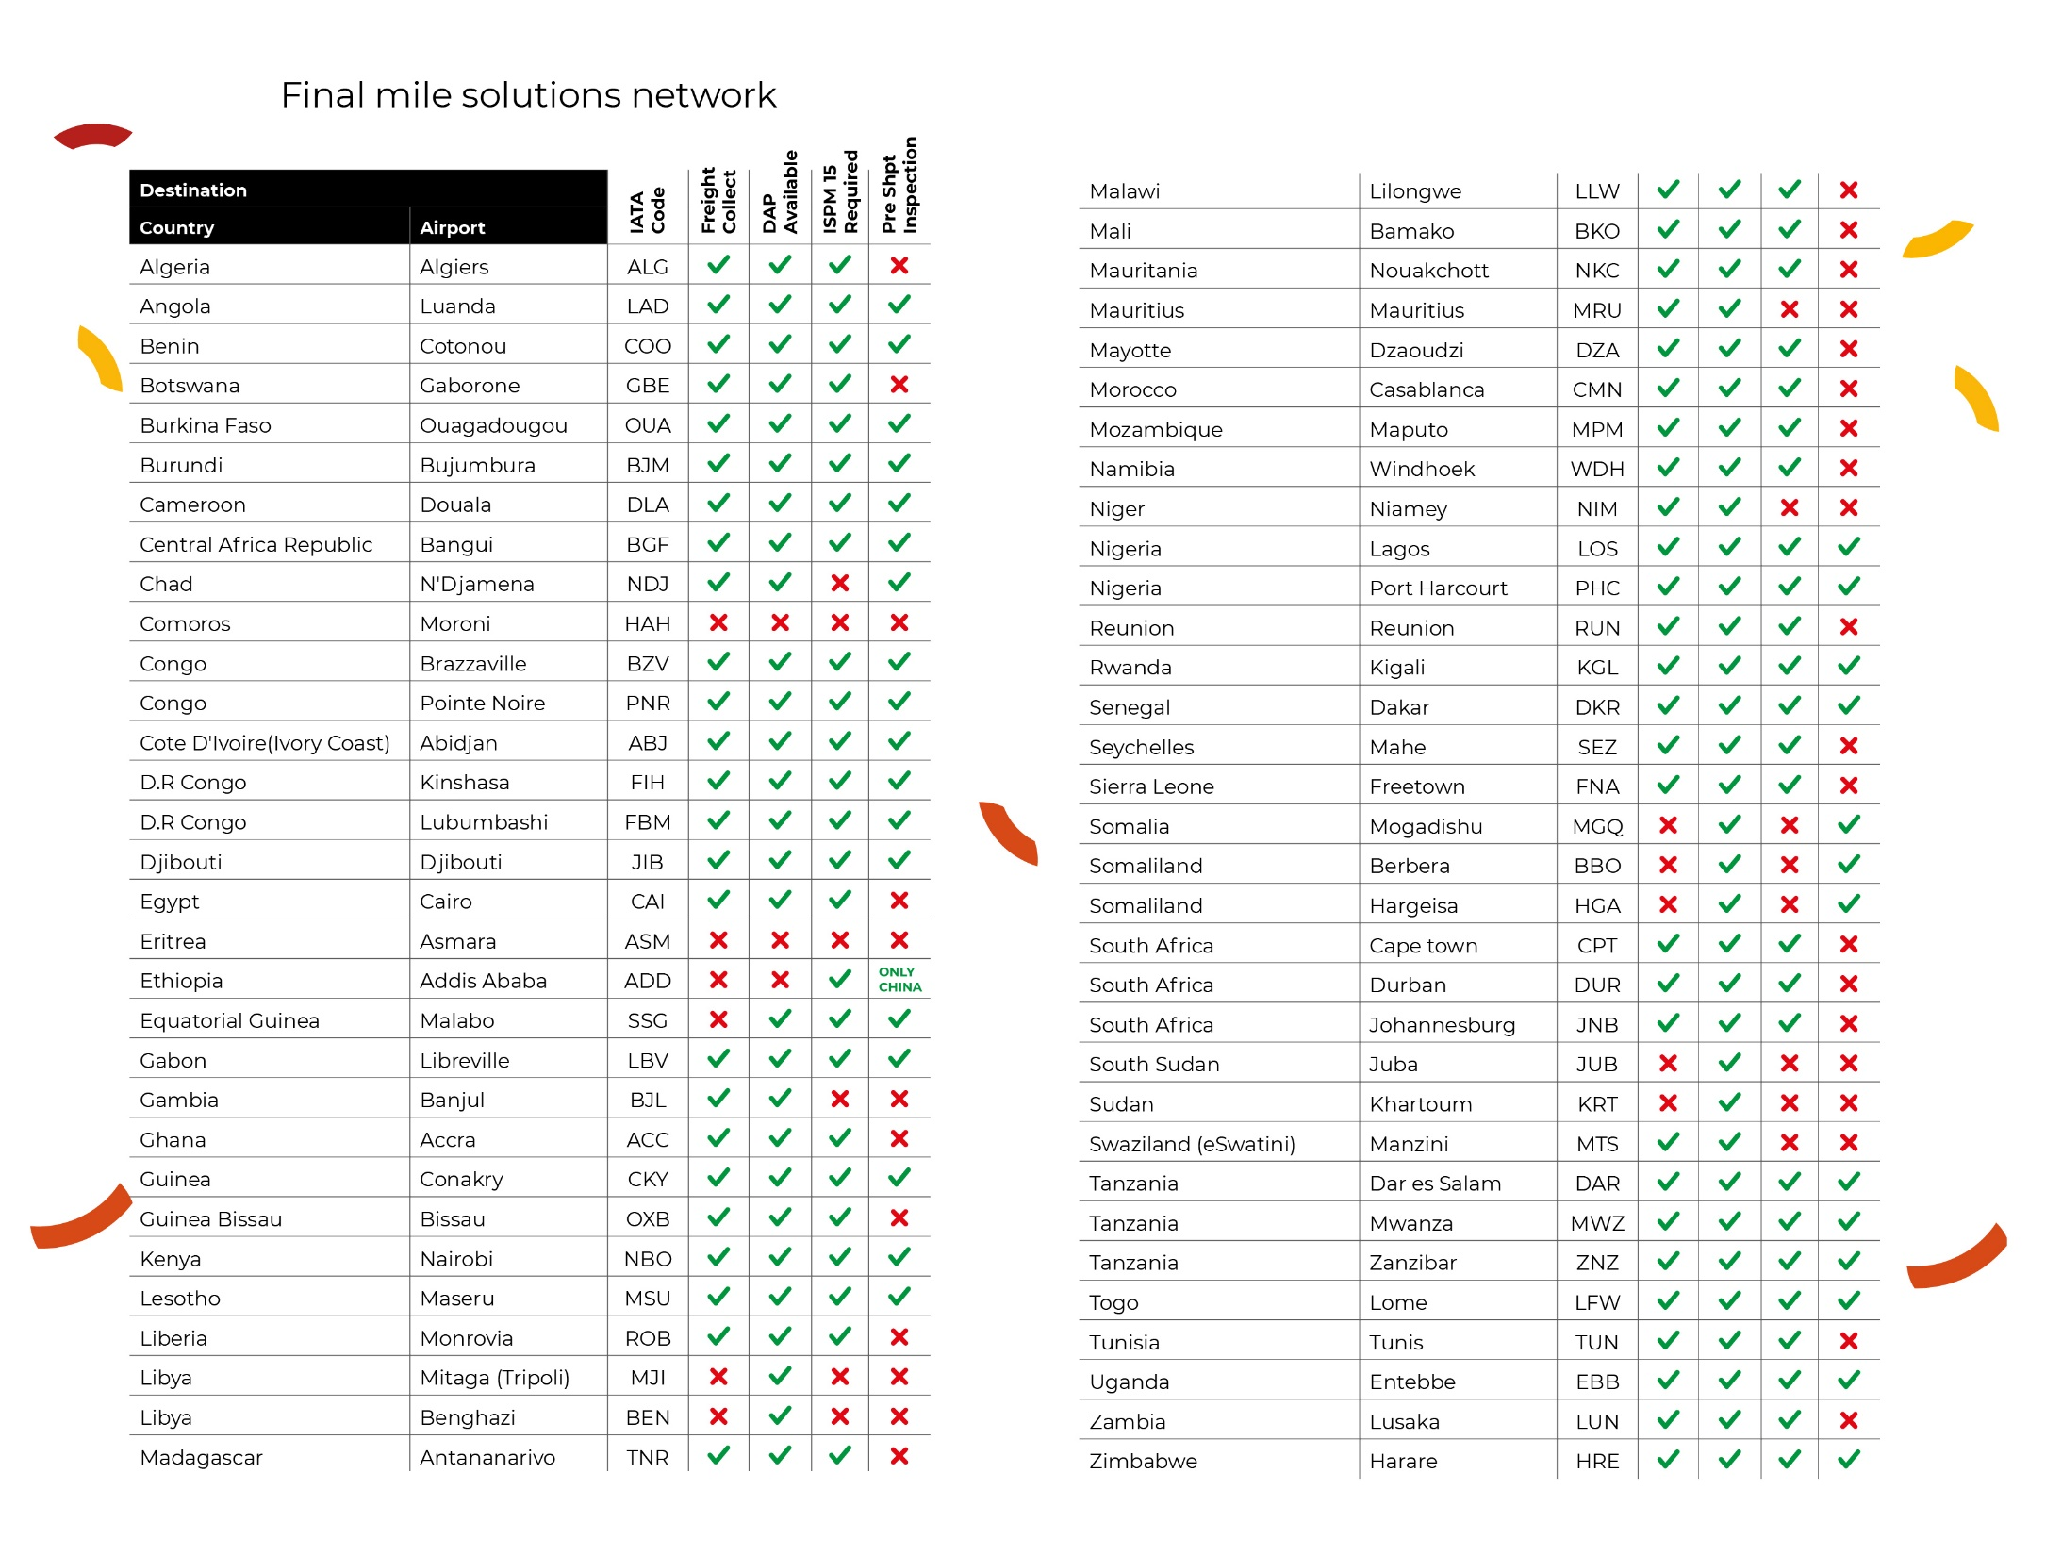
Destination
profile
QUICK VIEW

Slide 12


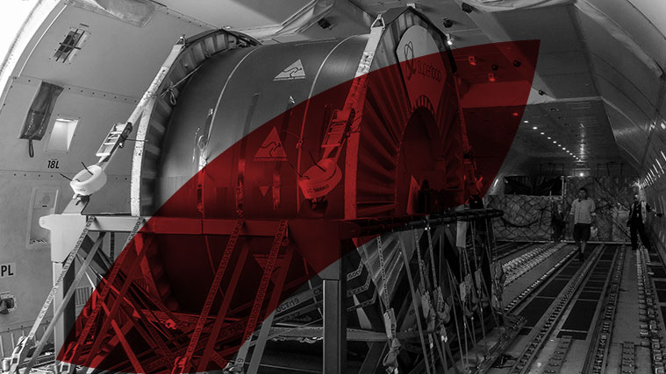
^{Time Critical}
^{Aero OBC}
Our time-critical dedicated team is experienced in humanitarian and NGO operations, Energy, Aerospace and Marine, as well as Pharma, clinical trial operations and special events logistics.
Aero OBC provides a premium global on-board courier wholesale platform through a courier network of 1500 OBCs worldwide in 125 countries and a state of art IT Platform. 24/7 – 365 days a year operation.
^{Aero Xpress}
AERO - X is our neutral wholesale express system tailor made to the needs of our airline, forwarder, and consolidator customers. With over 20 regional express carriers operating to and from Africa and instant rate and booking options, Aero-X express platform is easy, fast, reliable, and runs on all devices.

Slide 13



^{Charter Services}
^{SEA Air Solutions}
We provide charter services into Africa from major airports in Asia and the Americas via our European and Middle East gateways on behalf of our airline, consolidator and freight forwarder partners
Aero Africa offers tailor-made Sea/Air scheduled consolidation solutions from over 20 key ports in Asia via our hub in Dubai, Mombasa and Durban to over 80 destinations in Africa.
^{Gateway Solutions}
We offer gateway transit cargo solutions from EU JNB NBO DXB to the African continent. Our EU hubs are in LGG BRU AMS FRA LHR CDG all centrally located with daily direct freighter services to Africa connecting Europe and the Americas.
Our EU facilities are opened 24/7 and are equipped with modern ULD loading equipment and have the highest security standards

Slide 14







Shanghai: Do you have a cost-effective freighter solution to Lomé?
Bangkok: Can you handle a time definite temperature-controlled delivery to door Bamako?
Geneva: Do you offer aid & relief final mile services in South Sudan?
Frankfurt: Do you have air import services from Accra?
Mexico City: Can you help us with an automotive project to Morocco ?
New York: Can you handle 5 tones cross trade from Chengdu to Niamey ?
www.aero-africa.com
African neutral airfreight
logistic solutions 24/7
info@aero-africa.com

Slide 15

Accra: Do you have a cost-effective sea+air solution Ex-China?
Johannesburg: Can you help with weekly temp control shipments to the UAE?
Nairobi: How often is your air consol from Guangzhou to Nairobi?
Port Elisabeth: Can you assist with an urgent automotive parts shipment to Germany?
Johannesburg: Can we arrange contrast rates for our traffic from China?
Durban: Can we use your cross-border solution to neighboring countries?

Slide 16
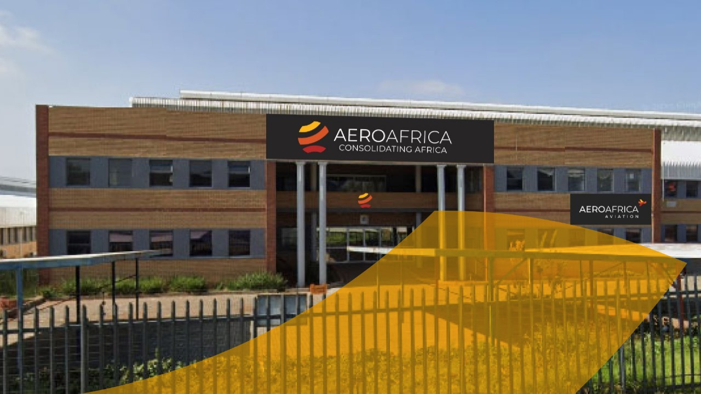
Highlights
+25,000 shipments annually,
+7 million kilos annually,
No 1 air imports consolidator in Southern Africa
Top 2 air exports consolidator in Southern Africa
Top 5 IATA cargo sales agent

Slide 17

Milestones
2016
The concept of establishing a neutral air cargo logistics network solution for Africa has emerged.
2017
Business plan implemented, and the fundraising phase has been successfully finalized
2018
Aero Africa Holding
( Air Cargo Solutions Ltd ) incorporated in Hong Kong
2018
Aero Africa Air Transport Services (Shanghai) was founded in China with the aim of offering Chinese freight forwarders impartial air cargo services and network solutions tailored for Africa
2019
Joined Neutral Air Partner & TIACA Associations
2020
Aero Africa Sub-Saharan Africa (Pty) Ltd was founded in Durban and Johannesburg, South Africa, with the mission of delivering neutral BSA scheduled consolidation services for imports to the trade.
2021
Aero Africa control towers were established in West & North Africa to serve global forwarders and the interests of the group in the region.
2022
Aero Africa Mashariki Cargo Solutions Ltd Nairobi Kenya was established in East Africa to serve the interests of the group in the region.
2022
Appointed as GSA/CSA of Omani based SalamAir Cargo Airline .
2020
Aero Africa control tower was established in Europe with the aim of offering European freight forwarders neutral air cargo services and network solutions tailored for Africa

Slide 18
Milestones
TODAY
African footprint in 50 countries and 84 airports with own offices and selected airfreight partners.
2023
Launch of our neutral consolidation & logistics center strategically located near JNB OR Tambo Intl airport.
2023
Accredited as an IATA CASS Associate
2024
Voted as Best Performing Partner Worldwide by the Neutral Air Partner organization and its members.
2023
Aero Africa International (Pty) Ltd was founded in Johannesburg, with the objective of offering unbiased air freight wholesale export services to the freight & logistics community
2023
Aero Africa control tower was established in Dubai UAE to serve the interests of the group in the region.
2024
Ranked No 1 neutral air Import consolidator in Southern Africa
2024
Establishment of Aero Africa Durban Airport branch at King Shaka International
2025
Launch of Aero Africa Fresh in Johannesburg located at OR Tambo International. Morocco and Egypt .
2026
Aero Africa Cape Town, South Africa, is fully operational, and Aero Africa Ghana is currently being developed to strengthen the Group’s presence and support its interests across the region.
2024
Appointed as GSA/CSA of Gulf Air Cargo Airline in Kenya
2024
Ranked among the top 3 air export consolidators and within top 10 IATA cargo agents in South Africa.

Slide 19









Service Centers
^{REGIONAL OFFICES}
^{SOUTHERN AFRICA}
^{AERO AFRICA SUB SAHARAN}
^{AFRICA (PTY) LTD}
Unit 4 B, 56 Armstrong Avenue, La
^{Lucia, Durban South Africa}
^{AERO AFRICA SUB SAHARAN}
^{AFRICA (PTY) LTD}
^{Same as below}
AERO AFRICA INTERNATIONAL (PTY) LTD
Unit D, Freeway Industrial Park
^{24 Pomona Road}
^{Pomona, Kempton Park, 1620}
^{Johannesburg, South Africa}
AERO AFRICA INTERNATIONAL (PTY) LTD
Unit 20, Dube Tradehouse, King Shaka International, Durban, South Africa
AERO AFRICA INTERNATIONAL (PTY) LTD
CTX Business Park, Freight Rd, Airport Industria, Cape Town, 7490 South Africa
^{NORTH AFRICA}
^{AERO AFRICA EGYPT}
142 banks Complex, 5th Settlement, New Cairo
^{Cairo, Egypt}
^{EUROPE}
^{AERO AFRICA EU}
^{Laodikis 41 3F Glygada}
^{Athens Greece 16674}
^{Europe}
AERO AFRICA FRESH (PTY) LTD Perishables Facility
In-flight services Building, OR Tambo International Airport
^{Kempton Park, 1620}
^{Johannesburg, South Africa}
^{CHINA}
AERO AFRICA AIR TRANSPORT SERVICES (Shanghai) LTD
Suite M605, 6F, SmartMart Office Tower; No. 2299 Yan’An Xi Road, Chang Ning, Shanghai
^{NORTH AFRICA}
^{AIR CARGO SOLUTIONS SARLAU LTD}
First office, 401 Route d’El Jadida N° 03 4th Floor, Casablanca, Morocco
^{EAST AFRICA}
^{AERO AFRICA MASHARIKI}
^{CARGO SOLUTIONS LTD.}
^{Airport Trade Centre}
J.Kenyatta International Airport
^{Nairobi, Kenya}
^{WEST AFRICA}
^{AERO AFRICA WAF}
^{Room 212, Swiss Port Building,}
^{Aviance Cargo Village,}
^{Kotoka International Airport,}
^{Accra Ghana}
^{CONTROL TOWERS}
^{CORPORATE HQ}
^{MIDDLE EAST}
^{AERO AFRICA MEI}
^{Dubai Airport Free Zone,}
^{Building E1, Office 311A,}
^{Dubai - U.A.E}
^{ASIA}
^{AERO AFRICA GROUP}
^{Air Cargo Solutions Ltd}
^{Queens road central 340,}
^{20 F RM 2006, Hong Kong}

Slide 20


Slide 21





NORTH AFRICA SPOTLIGHT
HOST SPONSOR
AERO AFRICA MOROCCO

Slide 22
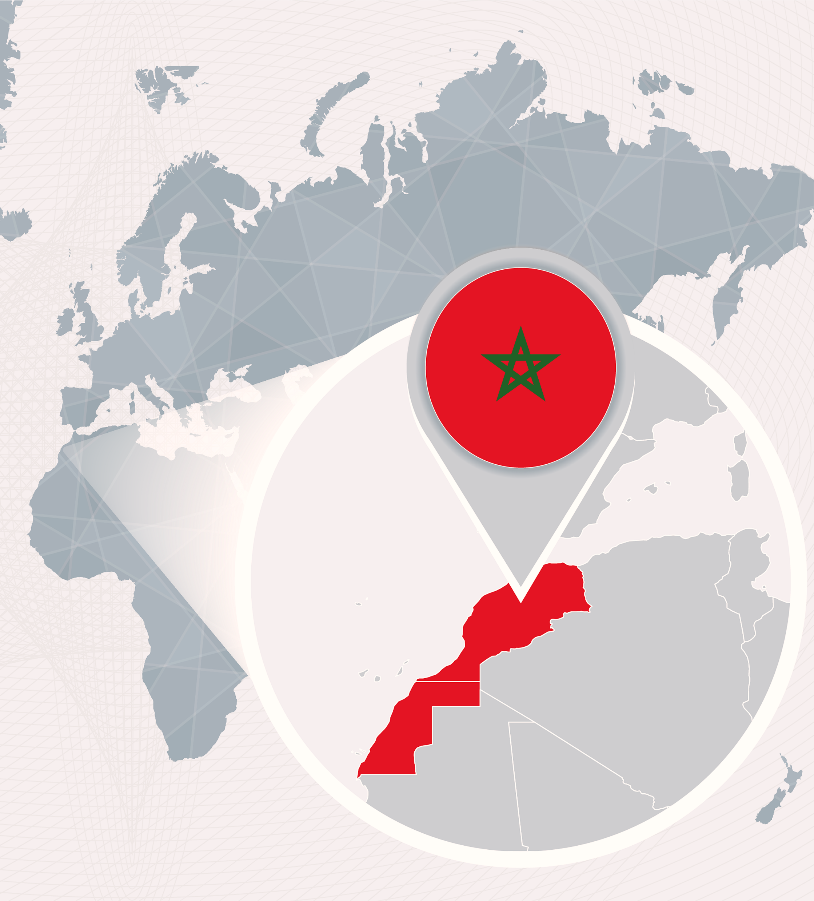








OVERVIEW
MOROCCAN AIR CARGO MARKET
KEY TRADELANES
MAIN INDUSTRIES
UAE
FRESH PRODUCES
EU
AUTOMOTIVE
+30% GROWTH
QATAR
BETWEEN 2022 AND 2025
AEROSPACE
CHINA & HK
USA
MACHINARY

Slide 23

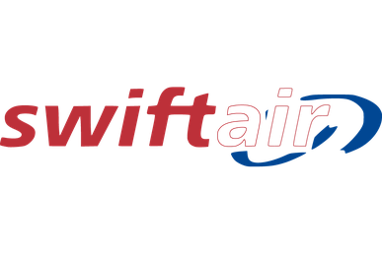


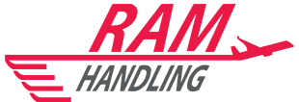

OVERVIEW
MOROCCAN ECOSYSTEM
MAIN CARGO HUB
REGIONAL AIRPORTS
GHAs
CMN
TNG
RAK
MARKET ECOSYSTEM
+10K
Transport & Logistics Operations
450
Active Freight Forwarders
140
IATA Accredited Agents

Slide 24

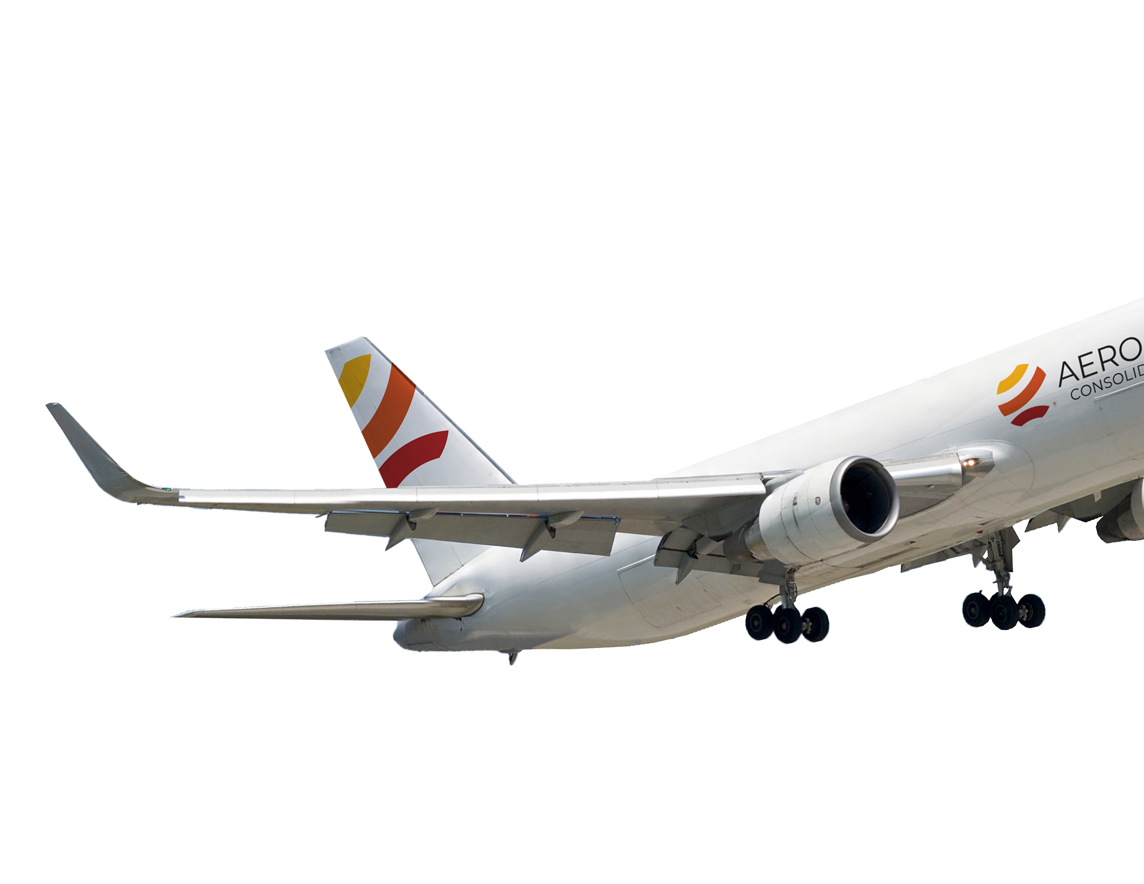


CONTROL TOWER
MARKET EXPERIENCE
North Africa Control Tower
Serving the Moroccan Market since 2020
  Neutral Import Consolidation
  African Solutions
  Charters & OBCs
Challenges Indentification
  Unfamiliarity with neutral wholesale airfreight models
  Uneserved clients (SMEs, Non IATA Agents...)
  Restricted airline access
  Hard reached GSAs
  Complicated airfreight operations

Slide 25






NEW ERA
UNLOCING NEUTRAL AIR CARGO
AN ACCESSIBLE, STRUCTURED & NEUTRAL AIR CARGO PARTNER
First Neutral Wholesaler
Services
Community Served
Strategic Partnerhips
Established office at CFC
Dedicated local team
End to End operational control
IATA CASS Associate
Neutral Export Services
Time-Critical & Charters
Airline Network Solutions
African Cargo Connectivity
SMEs
Non-IATA forwarders
Overseas agents
Airline partners
Airline relationships
Global cargo network
Operational expertise
IT Tools, Data and Statistics

Slide 26

MOROCCO
UNLOCKED

Slide 27





